Slide 1
UML Diagrams

Slide 2
What is UML?
At the end of the 1980s and the beginning of 1990s, the first object-oriented development processes appeared
The proliferation of methods and notations tended to cause considerable confusion
The Unified Modelling Language is a standard graphical language for modelling object oriented software
UML was developed as a collaborative effort by James Rumbaugh, Grady Booch and Ivar Jacobson, each of whom had developed their own notation
In 1997 the Object Management Group (OMG) started the process of UML standardization
Notes:
Two important methodologists Rumbaugh and Booch decided to merge their approaches in 1994.
They worked together at the Rational Software Corporation
In 1995, another methodologist, Jacobson, joined the team
His work focused on use cases

Slide 3
UML diagrams
Class diagrams
describe classes and their relationships
Interaction diagrams
show the behaviour of systems in terms of how objects interact with each other
State diagrams and activity diagrams
show how systems behave internally
Component and deployment diagrams
show how the various components of systems are arranged logically and physically

Slide 4
UML features
It has detailed semantics
It has extension mechanisms
It has an associated textual language
Object Constraint Language (OCL)
The objective of UML is to assist in software development
It is not a methodology
Notes:
Why use a standard modeling language?
Some developers have been successful at developing small software systems
without the use of diagrams or other features of modeling languages. However,
as their systems become larger and larger, such developers have an increasingly
difficult time seeing the ‘big picture’ and are liable to create poor designs and
take much longer in their work.
Since it is a standard notation, everybody who looks at the model will be able to
interpret it the same way.
Several diagrams can present the same information in slightly
different ways, either with different notations or with different levels of detail
A model can lead software engineers to have insights about the system; they
can analyze the model (manually or using tools) to discover problems and other
properties of it.

Slide 5
UML Class Diagram
A type of static structure diagram
In the design of a system, a number of classes are identified and grouped together that helps to determine the static relations between them.

Slide 6
Essentials of UML Class Diagrams
The main symbols shown on class diagrams are:
Classes
represent the types of data themselves
Associations
represent linkages between instances of classes
Attributes
are simple data found in classes and their instances
Operations
represent the functions performed by the classes and their instances
Generalizations
group classes into inheritance hierarchies

Slide 7
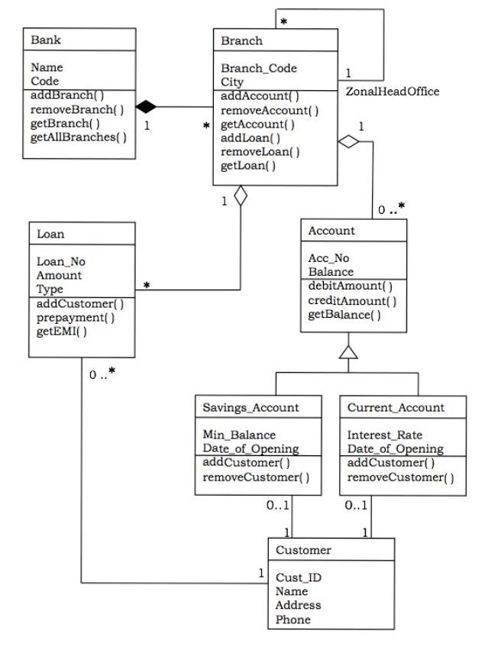
An Example

Slide 8
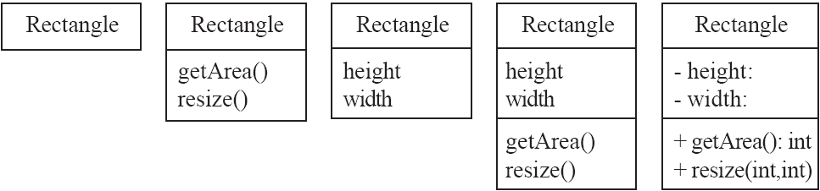
Classes
A class is simply represented as a box with the name of the class inside
The diagram may also show the attributes and operations
The complete signature of an operation is:
operationName(parameterName: parameterType …): returnType

Slide 9
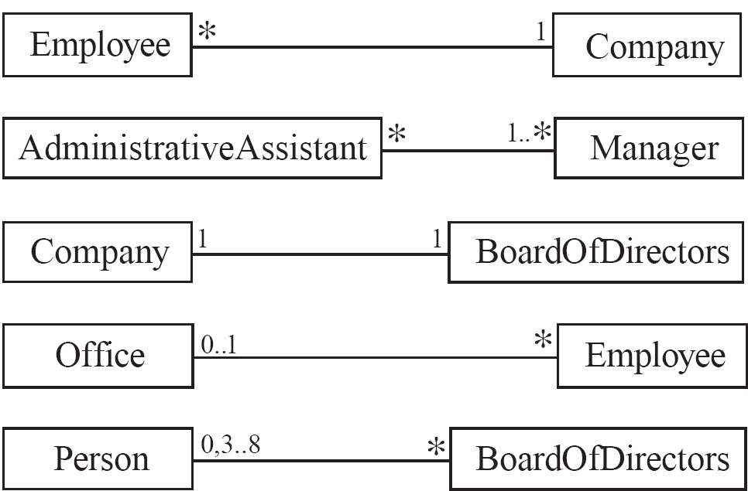
Associations and Multiplicity
An association is used to show how two classes are related to each other
Symbols indicating multiplicity are shown at each end of the association
Notes:
An association is used to show how instances of two classes will reference each
other. The association is drawn as a line between the classes.
Symbols indicating multiplicity are shown at each end of the association. The
multiplicity indicates how many instances of the class at this end of the
association can be linked to an instance of the class at the other end of the association.
Figure 5.2 gives some examples of associations, showing their
multiplicity.
0 No instances (rare)
0..1 No instances, or one instance
1 Exactly one instance
1..1 Exactly one instance
0..* Zero or more instances
Zero or more instances
1..* One or more instances
A very common multiplicity is ∗, which is normally read as ‘many’, and means
any integer greater than or equal to zero. If there can be either zero or one object linked to an object at the other end of
the association, then the multiplicity is said to be ‘optional’, and the notation 0..1
is used. k; therefore 0..∗ and ∗ mean the same
thing, while 1..∗ means ‘at least one’.
Specific multiplicities involving intervals or exact numbers greater than two
are not common, and should only be specified after careful thought
A more reasonable multiplicity for parents might be 0..2.
If you do not specify the multiplicity of an association end, then it is said to be
undefined. We strongly recommend never leaving a multiplicity undefined,
since much of the meaning of a class diagram comes from the multiplicities. In
some earlier versions of UML, leaving the multiplicity blank meant it should be
interpreted as ‘one’ rather than undefined; you may see some older diagrams
using this convention.

Slide 10
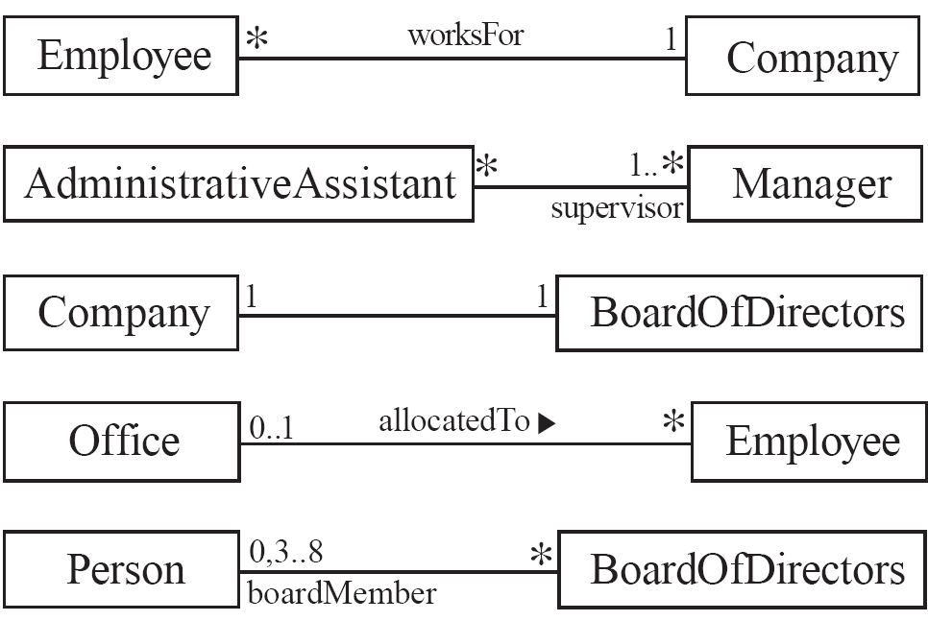
Labelling associations
Each association can be labelled, to make explicit the nature of the association
Notes:
Each association can be labeled, to make explicit the nature of the association.
There are two types of labels, association names and role names.
An association name should be a verb or verb phrase, and is placed next to the
middle of the association. One class becomes the subject and the other class
becomes the object of the verb. For example, the association between Employee
and Company is called worksFor. You can read the association in one direction as,
‘an employee works for a company’. The direction to read the association is
normally obvious, but can be clarified by showing a little arrow (a filled triangle)
next to the association name (as in the fourth association in Figure 5.3).
Another way of labeling an association is to use a role name. Role names can
be attached to either or both ends of an association. A role name acts, in the
context of the association, as an alternative name for the class to which it is
attached. For example, in the association between Person and BoardOfDirectors,
boardMember is a role name that describes the people who happen to be members
of the board.
If you omit both the association name and role names, then consider that an
association’s name is simply has, by default. This

Slide 11
Analyzing and validating associations
Many-to-one
A company has many employees,
An employee can only work for one company.
A company can have zero employees
E.g. a ‘shell’ company
It is not possible to be an employee unless you work for a company
Employee
*
worksFor
1
Company
Notes:
Most
importantly, you should always ask yourself whether a less restrictive
multiplicity could also makes sense in some circumstances. By less restrictive,
we mean using ‘many’ or ‘optional’ instead of ‘one’ or some other specific
Number
the
other hand, using ‘many’, as opposed to ‘one’, when it is not justified, will
increase a system’s complexity and reduce its efficiency.

Slide 12
Analyzing and validating associations
Many-to-many
An assistant can work for many managers
A manager can have many assistants
Assistants can work in pools
Managers can have a group of assistants
Some managers might have zero assistants.
Is it possible for an assistant to have, perhaps temporarily, zero managers?
*
1..*
*
*
*
*
Assistant
*
Manager
supervisor

Slide 13
Analyzing and validating associations
One-to-one
For each company, there is exactly one board of directors
A board is the board of only one company
A company must always have a board
A board must always be of some company
1
1
Notes:
many’. The implication of a one-to-one association is that
whenever you create an instance of one of the classes, you must simultaneously
create an instance of the other; and when you delete one you must delete the
other. If

Slide 14
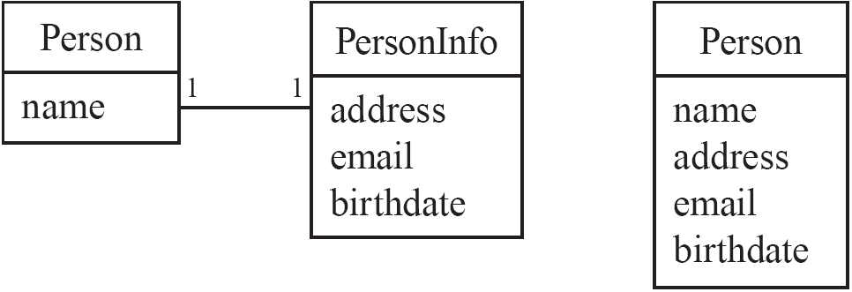
Analyzing and validating associations
Avoid unnecessary one-to-one associations
Avoid this do this

Slide 15
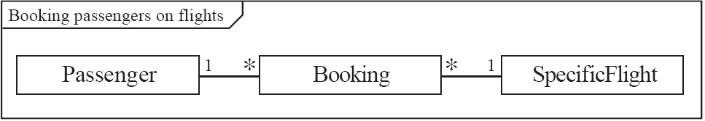
A more complex example
A booking is always for exactly one passenger
no booking with zero passengers
a booking could never involve more than one passenger.
A Passenger can have any number of Bookings
a passenger could have no bookings at all
a passenger could have more than one booking
The frame around this diagram is an optional feature that any UML 2.0 may possess.

Slide 16
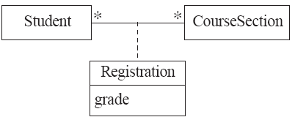

Association classes
Sometimes, an attribute that concerns two associated classes cannot be placed in either of the classes
The following are equivalent
Notes:
In some circumstances, an attribute that concerns two associated classes cannot
be placed in either of the classes. For example, imagine the association shown in
Figure 5.6, in which a student can register in any number of course sections, and
a course section can have any number of students. In which class should the
student’s grade be put?
Any time you see a many-to-many association, you should consider
whether an association class is needed.
The fact that an association class has two many-to-one associations means
that to create an instance, you must already have instances of the two
associated classes.

Slide 17
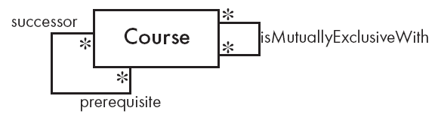
Reflexive associations
It is possible for an association to connect a class to itself
Notes:
Reflexive associations
It is possible for an association to connect a class to itself. Two examples of this
are found in Figure 5.8. A course can require other prerequisite courses to be
taken first. If two courses cover nearly the same material, taking one of them
may preclude a student from taking the other, and vice versa – such courses
are said to be mutually exclusive. The first association is asymmetric, since the
roles of the classes at each end are clearly different. The second, on the other
hand, is symmetric. To make the meaning clear, you should label an
asymmetric reflexive association using role names instead of an association
name.

Slide 18
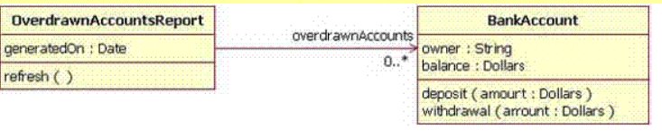
Directionality in associations
Associations are by default bi-directional
It is possible to limit the direction of an association by adding an arrow at one end
Notes:
Links as instances of associations
Associations and links are by default bi-directional.
In a uni-directional association, two classes are related, but only one class knows that the relationship exists.
An example of a uni-directional association: The OverdrawnAccountsReport class knows about the BankAccount class, but the BankAccount class does not know about the association

Slide 19
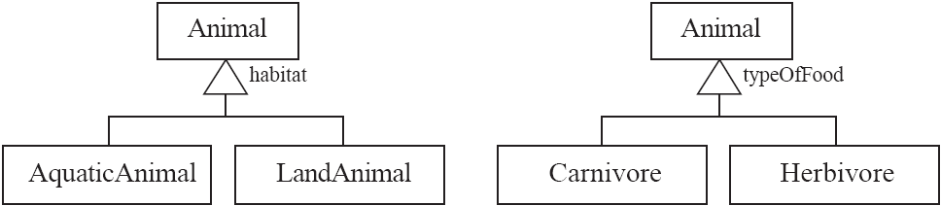
Generalization
Specializing a superclass into two or more subclasses
A generalization set is a labeled group of generalizations with a common superclass
The label (sometimes called the discriminator) describes the criteria used in the specialization

